Slide 1
Md. Ariful Islam Assistant System Engineer MIST Email: ariful.uiu.cse@gmail.com Phone: 01521102157

Slide 2
Overview
What is Multimedia?
Definition of Multimedia
Category of Multimedia
Basic Elements of Multimedia
Difference between Graphics and Animation
Applications of Multimedia
ADVANTAGES and DISADVANTAGES of Multimedia
Different types of multimedia editing software

Slide 3
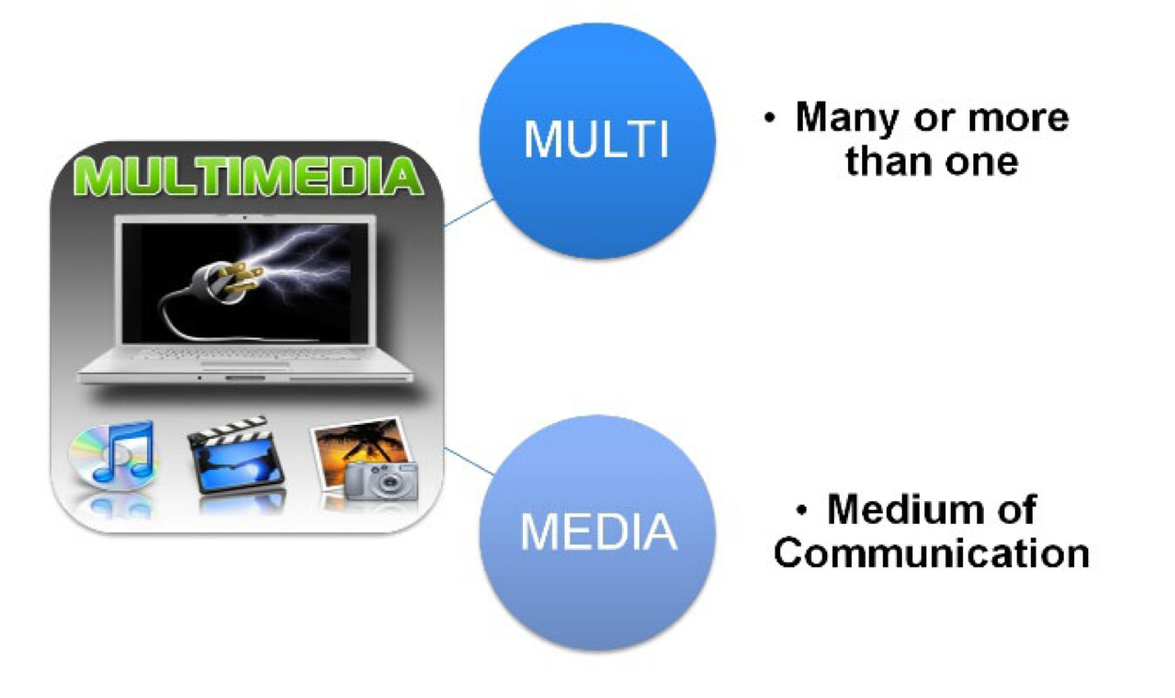
What is Multimedia?

Slide 4
Definition of Multimedia
Multimedia is a combination of text, graphics, audio, animation, Images and videos to effectively communicate ideas to users.

Slide 5
Category of Multimedia
Linear Multimedia is a type of a multimedia that is designed to be presented in a sequential manner. It has a distinct beginning and end.
Linear
Non-linear multimedia is a nonsequential type of multimedia. In this type of media, the person needs to interact with a computer program, thus making him in control of the experience.
Non Linear

Slide 6
Basic Elements of Multimedia
Text
Graphics
Audio
Animation
Video
Image

Slide 7

Basic Elements of Multimedia
Text
Text is the most widely used and flexible means of presenting information on screen and conveying ideas.
Most multimedia systems use a combination of text and other media to deliver functionality.
Text is and essential aspect of presenting the information.
Some Common Text File Formats are TXT, DOC, RTF, LTX etc.

Slide 8

Basic Elements of Multimedia
Audio
Audio refers to sound. Multimedia can include files which contain sound, songs also come under the heading multimedia.
Audio files and streams play a major role in some multimedia systems.
Some Common Audio File Formats are MP3, WAV, AAC, AIFF, WMA etc.

Slide 9

Basic Elements of Multimedia
Video
A video is unedited material as it had been originally filmed by movie camera of recorded by a video camera.
The embedding of video in multimedia applications is a powerful way to convey information which can incorporate a personal element which other media lack.
Some Common Video File Formats are MP4, MOV, WMA, AVI, MKV etc.

Slide 10

Basic Elements of Multimedia
Image
Images are very useful feature of multimedia. Multimedia presentation uses pictures or clip-art to make people understand.
Picture (Images) is two-dimensional screen display, and as well as three-dimensional, such as a statue of hologram.
Some common Image file formats are JPEG, PNG, PSD, PDF, AI etc.

Slide 11
Basic Elements of Multimedia
Animation
Animation is a process of making a static image look like it is moving.
An animation is just a continuous series of still images that are displayed in a sequence.
The animation can be used effectively for attracting attention.
Some common Animation file formats are FLA, GIF, DHTML etc.

Slide 12
Basic Elements of Multimedia
Graphics
Graphics make the multimedia application attractive. In many cases people do not like reading large amount of textual matter on the screen.
Graphics are used more often than text to explain a concept, present background information.
Some common Graphics file formats are GIF, PNG, BMP, SVG etc.

Slide 13
Difference between Graphics and Animation
The main difference between Graphics and Animation is that the Graphics is a visual presentation on some surface and Animation is a process of creating animated films and series.

Slide 14
Applications of Multimedia
Business
Entertainment and fine arts
Education
Social work
Journalism
Engineering
Mathematical and scientific research
etc.

Slide 15
ADVANTAGES
Increases learning effectiveness
Multimedia enhances the effect of text presentations.
Reduces training costs
Use for Entertaining and educational purposes
Provides high Quality of Presentations

Slide 16
DISADVANTAGES
Expensive
Not always ready to configure
Complex to create
Requires special hardware
Not always compatible
Takes time to compile

Slide 17
Different types of multimedia editing software
MS Word
Cool Edit Pro
Adobe Premier Pro
Adobe After Effects
Adobe Photoshop
Adobe Illustrator
Adobe Flash
Corel Draw
3D studio max
Maya

Slide 18
Pixel
Smallest unit of a image
Term "pixel" is actually short for "Picture Element”
In digital imaging, a pixel or picture element is a physical point in a raster image, or the smallest addressable element in an all points addressable display device.

Slide 19
Resolution
How many pixels are displayed per square inch of an image.

Slide 20
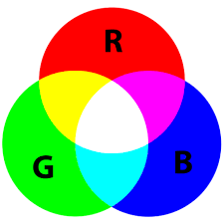
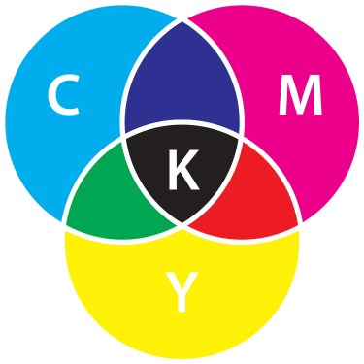
Colors
RGB
CMYK

Slide 21


Slide 22
References
https://groupsevenmultimedia.wordpress.com/linear-and-non-linear-multimedia/#:~:text=Linear%20Multimedia%20is%20a%20type,or%20distraction%20from%20the%20audience.
http://frndzzz.com/advantages-and-disadvantages-of-multimedia
https://fileinfo.com/filetypes/text
https://www.makeuseof.com/tag/audio-file-format-right-needs/
https://www.adobe.com/creativecloud/video/discover/best-video-format.html
https://blog.hubspot.com/insiders/different-types-of-image-files
https://fileformatforanimation.weebly.com/
https://www.ionos.com/digitalguide/websites/web-design/graphic-file-formats-which-formats-are-important/

